Slide 1

PA Global HackSummit 2024,​​
​​
Courage to Change​​
​​
Take bold steps​​
Challenge old norms​​
Drive transformative innovation​
​

Slide 2
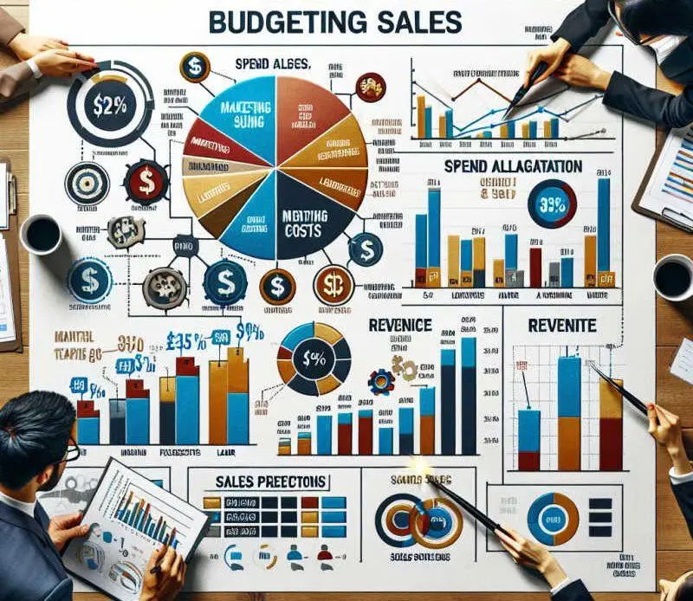
Cost and Budget Simulator for preparing Budgets
By Bharath Kumar Challagundla

Slide 3
Elevator Pitch:
In today's fast-paced and dynamic financial environment, individuals and organizations often struggle to manage their finances effectively. The complexity of balancing multiple income streams, handling variable and fixed expenses, and planning for future financial goals can lead to suboptimal financial decisions, inefficiencies, and potential financial instability. Existing financial tools may lack versatility, user-friendliness, or the ability to simulate diverse financial scenarios.
The "Cost and Budget Simulator" project seeks to address this challenge by developing a robust and intuitive tool that enables users to model, analyze, and optimize their financial situations. This simulator will allow users to input key financial parameters—such as income sources, fixed and variable expenses, investment options, and financial goals—providing them with actionable insights to make informed financial decisions and achieve long-term sustainability. The goal is to create a solution that simplifies financial planning while offering flexibility and precision to cater to a wide range of users and financial scenarios.

Slide 4
Cost and Budget Simulator: Streamlining Budget Preparation
The Cost and Budget Simulator is a powerful tool designed to simplify and enhance the process of preparing budgets. Whether you're managing personal finances, planning a business project, or overseeing a large-scale operation, this simulator helps you forecast, plan, and optimize your expenses effectively.

Slide 5
State of the Art:
Artificial Intelligence (AI) and Machine Learning (ML)
Predictive Analytics for Budgeting:
Forecasting Future Costs and Revenues: AI models can analyze historical financial data to predict future trends in expenses, revenues, and cash flow. This allows businesses and individuals to anticipate future budget needs with greater accuracy, accounting for seasonality, market changes, and external factors like inflation.
Dynamic Cost Modeling: AI can generate real-time cost models that adjust based on input changes. For example, if a project’s scope changes, AI can instantly recalculate how that impacts the budget, suggesting where to allocate or save resources.
Automated Budget Adjustments:
AI-Driven Budget Recommendations: AI algorithms can monitor the current state of a budget and recommend adjustments based on real-time data. For instance, if a project is overspending in one area, AI could suggest reducing costs in another area or recommend cheaper alternatives.
Adaptive Budgeting: AI-powered systems can adjust the budget dynamically as new financial data becomes available. This allows users to make real-time decisions and keep budgets on track without manual intervention.

Slide 6
Cost Optimization Algorithms:
AI for Resource Allocation: AI can optimize resource allocation, suggesting where to allocate funds for maximum efficiency. By analyzing data patterns and identifying inefficiencies, AI helps cut unnecessary costs while achieving project goals.
Optimization for Large-Scale Projects: For complex budgets with multiple components, machine learning algorithms can find the most efficient way to allocate resources across departments or projects, identifying the areas with the highest return on investment (ROI).
Risk Management:
Anomaly Detection: Machine learning models can detect unusual patterns in spending or revenues, alerting users to potential fraud, unexpected expenses, or deviations from the budget that need attention.
Scenario Planning: AI-powered simulators can run multiple "what-if" scenarios to test how different variables (e.g., economic downturns, regulatory changes, or supply chain disruptions) impact a budget. This helps organizations prepare for various outcomes and mitigate risks.

